Slide 1
Chronozoomers’ Time Challenge Cards
Develop your ability to navigate through time to discover information.

Slide 2
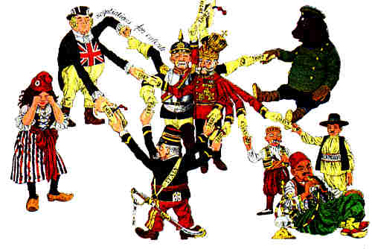
This cartoon represents the various European powers (many with multiple arms) tangled up with one another.
Why did the artist choose to show Europe in this manner?
How does this cartoon depict one of the causes of World War I?
Where would this cartoon fit on your timeline?
http://www.worldwar1.com/tlwarorg.htm
Notes:
The cartoon represents the various European powers (many with multiple arms) tangled up with each other. Why do you suppose the artist chose to show Europe in this manner? To what cause of World War I is this cartoon related? (How does this cartoon depict one of the causes of World War I?) Where would this cartoon fit on your timeline?

Slide 3
Assassination and July Crisis 1914
Why do you think that the July Crisis of 1914 following the assassination of the Archduke ended in World War?
Why did someone want to kill him?
Why have people associated his death with the start of the war?
Did it really change large patterns of history?
Did his death actually cause anything?

Slide 4
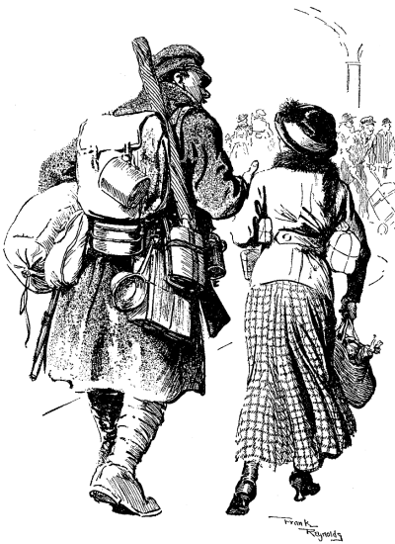
A British soldier offers to help a woman with her shopping bags.
Use the cartoon to describe the nature of British soldiers according to the artist.
Place the cartoon on your timeline.
After which date would this cartoon have appeared?
“I say, old girl, do let me carry something.”
http://www.worldwar1gallery.com/politicalcartoons/
Notes:
A British soldier offers to help a woman with her shopping bags. Use the cartoon to describe the nature of British soldiers according to the artist. Place the cartoon on your timeline. After which date would this cartoon have appeared?

Slide 5
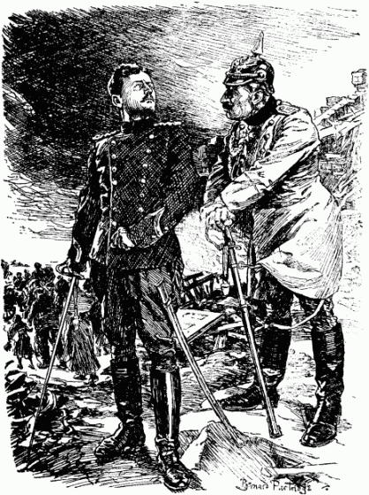
Here the German Kaiser mocks the Belgian King, claiming the King has lost everything.
Why would the artist depict the Kaiser speaking to the King this way?
To what event does this cartoon refer?
Where would the cartoon fit on your timeline?
Kaiser: So you see, you’ve lost everything.
Belgian King: Not my soul.
http://www.worldwar1gallery.com/politicalcartoons/
Notes:
Here the German Kaiser mocks the Belgian King, claiming the King has lost everything. Why would the artist depict the Kaiser speaking to the King this way? What event does this cartoon refer to? Where would the cartoon fit on your timeline?

Slide 6
Agreements and Alliances
Why did some states (Austria, Italy) choose to ally with Germany?
Why did other countries (Russia, France) feel threatened by Germany?
Do you think Germany felt threatened or concerned about any other countries?

Slide 7
German Unification (1871)
How did the formation/unification/creation of Germany change Europe?
How did German unification make Europe more stable or less stable?

Slide 8
1914 August
What evidence can you find that suggests as David Lloyd George (the British Chancellor in 1914) argued that Europe just “slithered in to War”?

Slide 9
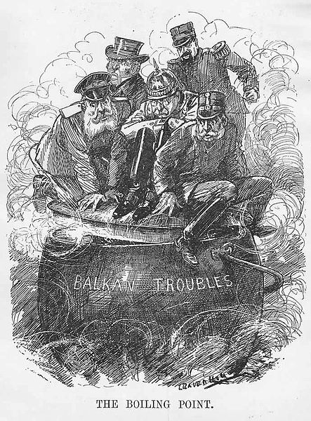
Years before World War I, Otto Von Bismarck predicted that “the next war will come from some damn fool thing in the Balkans.”
How does this cartoon relate to Bismarck’s quote?
What countries are located on the Balkan Peninsula?
Did trouble in the Balkans lead to war?
At what point on your timeline would this cartoon fit?
http://commons.wikimedia.org/wiki/File:Balkan_troubles1.jpg
Notes:
Years before World War I, Otto Von Bismarck predicted that “the next war will come from some damn fool thing in the Balkans.” How does this cartoon relate to Bismarck’s quote? What countries are located on the Balkan Peninsula? Did trouble in the Balkans lead to war? At what point on your timeline would this cartoon fit?

Slide 10
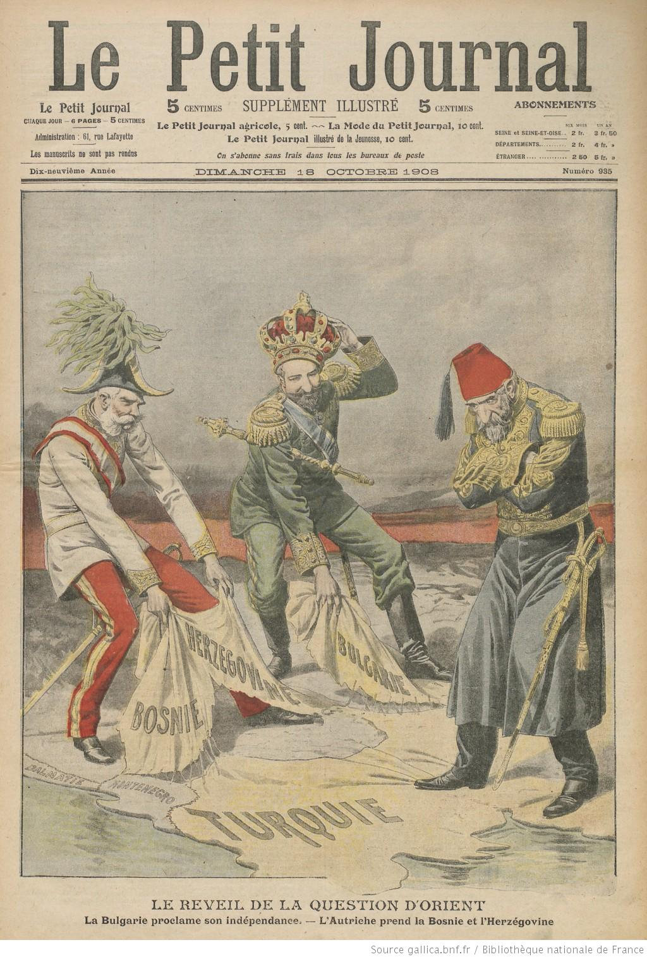
This French cartoon shows the powers of Europe dividing territory during the First Balkan War. Austria-Hungary takes control of Bosnia-Herzegovina, and Russia takes Bulgaria. Meanwhile the Ottoman empire stands, arms crossed, trying to keep a foothold on Turkey.
Where would the First Balkan War fit on your timeline?
How does the event shown in the cartoon relate to what you know about World War I?
http://gallica.bnf.fr/ark:/12148/bpt6k7168227
Notes:
This French cartoon shows the powers of Europe dividing territory during the First Balkan War. Austria-Hungary takes control of Bosnia-Herzegovina, and Russia takes Bulgaria. Where would the First Balkan War fit on your timeline? How does the event shown in the cartoon relate to what you know about World War I?

Slide 11
German Unification
How did German Unification inspire some young states such as Serbia?

Slide 12
Alliances and Agreements
What events and factors shaped the nature of the alliance system?
Why did your Britain choose to ally with France?
Why did Russia choose to ally with Britain and France?

Slide 13
Causes of World War I
Which of these views do you most agree with based on your Chronozooming? Provide details.

Slide 14
Agreements and Alliances
Why and when did France and Russia sign an agreement?
What did the agreement become an alliance and what did it obligate them to do?
Why did Britain join in agreement with France and Russia?

Slide 15
The sick man of Europe
Did the Ottoman Empire get stronger or weaker from 1878 to 1914? Why did it matter to the overall global picture and the lead up to World War I?

Slide 16
The Russian Empire
Who defeated Russia in 1905?
What did Russia’s defeat in 1905 mean for Asia? For Europe?
Why did an American president play the key role in reaching a peace settlement?

Slide 17
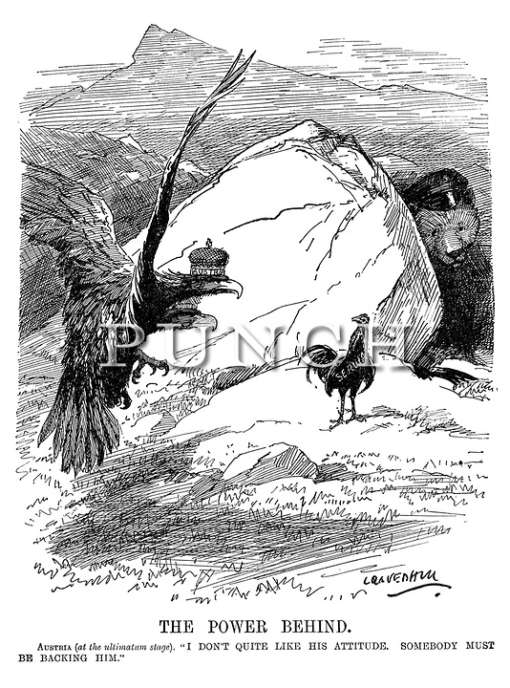
In this cartoon, Austria is represented by the eagle, Serbia by the rooster and Russia by the bear.
When does the Austrian ultimatum fit into your timeline? What demands did Austria make in the ultimatum and what was Serbia’s response?
Austria: I don’t quite like his attitude.
Somebody must be backing him.
http://punch.photoshelter.com/image/I0000IuhA19N6Uho
Notes:
In this cartoon, Austria is represented by the eagle (?), Serbia by the rooster (?) and Russia by the bear. When does the Austrian ultimatum fit into your timeline? What demands did Austria make in the ultimatum and what was Serbia’s response?

Slide 18
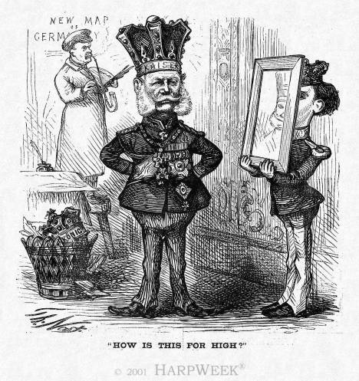
In this cartoon, Kaiser Wilhelm I admires his crown while Otto Von Bismarck re-draws the map of Germany in the background.
Why do you think Bismarck is re-drawing the map of Germany?
To what event does this cartoon refer?
Where would that event fit into your timeline?
http://www.nytimes.com/learning/general/onthisday/harp/0107.html
Notes:
In this cartoon, Kaiser Wilhelm I admires his crown while Otto Von Bismarck re-draws the map of Germany in the background. Why do you think Bismarck is re-drawing the map of Germany? To what event does this cartoon refer? Where would that event fit into your timeline?

Slide 19
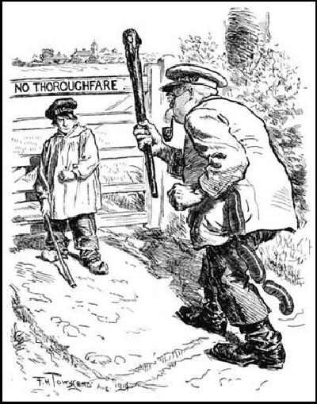
This cartoon depicts the Germans demanding to be allowed passage through a country in order to invade France.
Which country did Germany invade in order to move toward Paris?
After the invasion, which other European power joined the war effort?
Where would the invasion fit into your timeline?
http://histclo.com/essay/war/ww1/cou/w1c-bel.html
Notes:
This cartoon depicts the Germans demanding to be allowed passage through a country in order to invade France. Which country did Germany invade in order to move toward Paris? After the invasion, which other European power joined the war effort? Where would the invasion fit into your timeline?

Slide 20
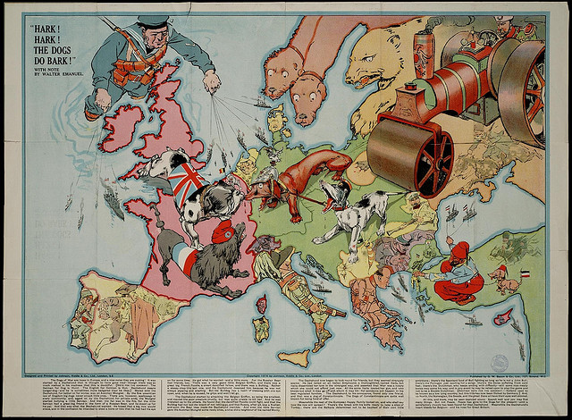
This cartoon depicts the Germans demanding to be allowed passage through a country in order to invade France. Which country did Germany invade in order to move toward Paris? After the invasion, which other European power joined the war effort? Where would the invasion fit into your timeline?
http://www.flickr.com/photos/bibliodyssey/2722416468/sizes/z/in/photostream/
Notes:
The text below the map begins “the dogs of war have been let loose in Europe.” Why do you think the cartoonist chose to represent the European countries in this manner? What do you think he is trying to say? Where could this map fit into your timeline?

Slide 21
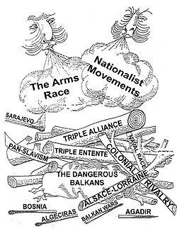
This cartoon shows various causes of World War I.
Which causes do you recognize?
Which ones do you think played the largest part in the outbreak of war?
Where would this cartoon fit into your timeline?
http://en.wikipedia.org/wiki/Wikipedia:Featured_picture_candidates/WWI_Causes
Notes:
This cartoon shows various causes of World War I. Which causes do you recognize? Which ones do you think played the largest part in the outbreak of war? Where would this cartoon fit into your timeline?

Slide 22
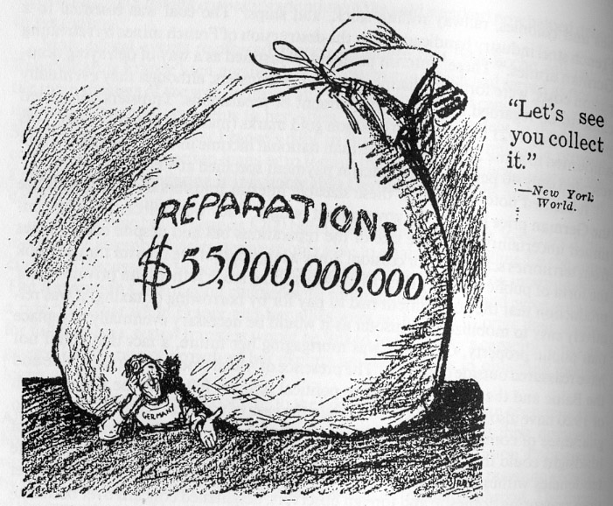
The cartoon depicts Germany under a heavy bag of reparations.
What is a reparation?
Why did Germany face reparations?
Who decided Germany would have to pay reparations?
Where would this cartoon fit into your timeline?
http://cla.calpoly.edu/~lcall/213/outline.depression.f03.html
Notes:
The cartoon depicts Germany under a heavy bag of reparations. What is a reparation? Why did Germany face reparations? Who decided Germany would have to pay reparations? Where would this cartoon fit into your timeline?

Slide 23
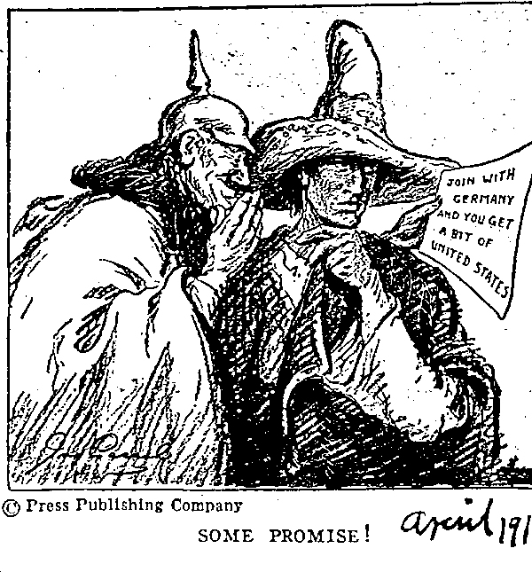
This cartoon depicts Germany talking to Mexico.
What do you think the discussion is about?
What did this event contribute to?
Where would this cartoon fit into your timeline?
“Join with Germany and you get a
bit of United States.”
https://www.mtholyoke.edu/~le20j/EventsBeforeWar.html
Notes:
This cartoon depicts Germany talking to Mexico. What do you think the discussion is about? What did this event contribute to? Where would this cartoon fit into your timeline?

Slide 24
The Franco –Russian Alliance Military Convention- August 18 1892
Which part of the Franco-Russian Alliance Military Convention came into play during World War I?
Map activity/question: Label the countries mentioned on the historybud. What position does this agreement put Germany in geographically?

Slide 25
Anglo-Japanese Alliance (1902)
Why do you think Britain was nervous about Russia’s Asian ambitions?
Why was an agreement between a European power and an Asian country such a big deal?

Slide 26
Anglo-French Entente, 1904
The word “Germany” never appeared in the Anglo-French Entente. What would Germany have to do with this treaty? If it did influence the treaty, why was it never mentioned by name?

Slide 27
The Anglo-Russian Entente (1907)
Would this treaty alter the Anglo-Japanese alliance from 1902?

Slide 28
Russian Agreements
Germany created alliances to protect itself from a perceived threat from Russia. How did Russia protect itself?

Slide 29
June 28th 1914
What happened that day?
Who was Gavrilo Princip?
Why did so many people at the time think that the events of June 28th and after were not a big deal and probably wouldn’t lead to a larger conflict?
So how significant was this event in causing World War I?

Slide 30
Economics
To what extent do you think different countries economic interests prevented or contributed to war, or both?

Slide 31
The Balkan Wars
Why was the phrase “sick man of Europe” used to describe the Ottoman Empire?
How did the condition of the Ottoman Empire lead to tensions in the Balkans?

Slide 32
Growth of Japan
Do you think Japan’s growth and victory over China in 1894-95 should have worried Russia and the European powers? Why?
Why was a strong Asian power a threat to Russia? To the rest of Europe?

Slide 33
Understanding the Schlieffen Plan
Why did Germany want to attack France through Belgium? What was Belgium’s role/position in all this?
To what extent do you think such military plans made the decision to go to war easier that if there were no military plans?
Why did Germany view Russia as such a military threat?
Do you think there were any weaknesses in the Schlieffen plan?

Slide 34
Ultimatum of July 23rd 1914
Why do you think many European countries immediately begin to mobilize after the ultimatum was issued?

Slide 35
Ultimatum of July 23rd 1914
Why do you think Austria-Hungary designed the ultimatum in the way it did? What was their goal?

Slide 36
The Moroccan Crisis
What were the two Moroccan crises really about? What did it say about Europeans and their desires to control Africa?

Slide 37
The Blame Game
Which events in the time vine do you consider to be the most significant causes for the outbreak of World War I? (Explain why?)
Who should be held responsible for World War I? Why?

Slide 38
The Ottoman Empire
Did the Ottoman Empire get stronger or weaker from 1878 to 1914? Why did it matter to the overall global picture?

